Slide 1
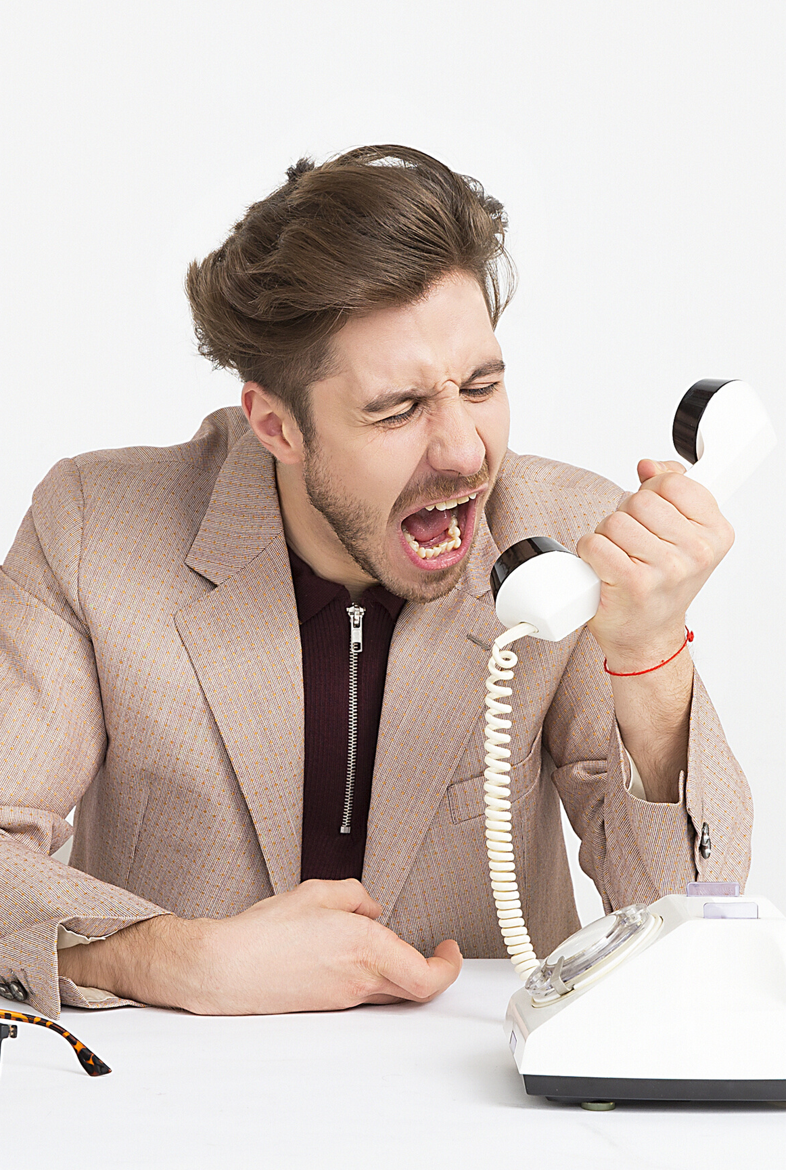
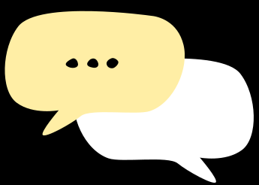
Business
Communication – Session C
Different Communication Etiquettes
COMPANY NAME | YEAR

Slide 2
Email Etiquettes
Effective Meetings
P.I.T.C.H
Telephone Etiquettes
Objectives
Key Points
COMPANY NAME | YEAR

Slide 3


Your Accounts
Seperate Personal & Professional Accounts always
cutiepie123@gmail.com
firstname.lastnam@gmail.com
COMPANY NAME | YEAR

Slide 4
Subject Line – Short and Simple
Greeting Mr., Dr., Mrs., Dear,
Introduction - Brief and to the point
Body – Explain the reason for email and DDL / Follow-Up date.
Closing - Thank them for their time
Initial Email Etiquette
COMPANY NAME | YEAR

Slide 5
Greeting – Thank you for returning your email
Addressee – Respond to them as the signed the response
Closing – Thank them again
Follow – Up Email

Slide 6
Don’t automatically reply to all
Always take a look at the Distribution
List – is this email necessary for all recipients.
Use the To: and CC: addresses appropriately.
Once the email discussion goes beyond 2-3 replies anyway, it is time to pick up the phone.
Think before you Click
COMPANY NAME | YEAR

Slide 7
Standardize Signature
By email settings
Wise-stamp
Do not use contractions (ex. Don’t, can’t)
Be more professional than them to be on safe
Use standard font throughout the message content. Avoid colored fonts in a professional email.
General Etiquette
COMPANY NAME | YEAR

Slide 8
Be very specific with the use of bold, italic or underline font style
Keep the size of the font visible and constant
Paragraph and line spacing should be legitimate and visually appealing
Avoid short forms or slang (e.g. ‘u’ instead of ‘you’, ‘y’ instead of ‘why’, ‘r’ instead of ‘are’, etc.)
General Etiquette(contd.)
COMPANY NAME | YEAR

Slide 9
Brainstorm
Planning
Collaboration
Tracking
Revision and Review
Performance
Evaluation
Why do we have Meetings?
COMPANY NAME | YEAR

Slide 10
Ask for agenda topics (regular meetings)
Organise an agenda
Topic
Time Limit
Send out the agenda
Before the Meeting
COMPANY NAME | YEAR

Slide 11
Start and End on time
Don’t wait for late comers
Stick to the agenda
Avoid conflict
SMART deadlines
Take Output
Be aware of your behaviour
During the Meeting
COMPANY NAME | YEAR

Slide 12
Edit Output
Thank attendees (especially those on time)
Send output
Follow up on Deadlines
Get Feedback
What did you do well?
What do you need to improve on?
Time check
After the Meeting
COMPANY NAME | YEAR

Slide 13
Telephone Etiquettes
Rules and Manner
Always remember your voice has to be very pleasant while interacting with the other person over the phone.
Never call any person at odd hours.
In any official call, don’t use words like” Any guess who I am?
Make sure your content is crisp and relevant.
After dialing, always reconfirm whether the person on the other side is the person you wish to speak to.
An individual needs to follow a set of rules and regulations while interacting with the other person over the phone.
COMPANY NAME | YEAR

Slide 14
Telephone Etiquettes
Rules and Manner(contd.)
Always carefully dial the numbers, never be in a rush.
Never put the second party on a very long holds.
While interacting over the phone, don’t chew anything or eat your food.
After completing the conversation, don’t just hang up.
Always speak each and every word clearly.
An individual needs to follow a set of rules and regulations while interacting with the other person over the phone.
COMPANY NAME | YEAR

Slide 15
Telephone Etiquettes
Rules and Manner(contd.)
Don’t take too long to pick up any call.
In professional talks, never keep the conversation too long as the other person might be busy.
If you are not the correct person and the speaker needs to speak to your fellow worker always say “one moment please- Iwill call him in a minute”.
Decrease the volume of the television or turn off the speakers.
If there is any disturbance in the network, don’t just keep speaking for the sake of it;
An individual needs to follow a set of rules and regulations while interacting with the other person over the phone.
COMPANY NAME | YEAR

Slide 16
Voice Tone
It pertains to Pitch, Volume, Pace and Emphasis
People quickly respond to voice tone either positively or negatively.
Good voice tone
Speaker with a deeper tone
Variability of tones
Speak slower
Give enough time for your voice to sink in.
COMPANY NAME | YEAR

Slide 17
Thank You!

